Slide 1
DATA SCIENCE SQL MINI PROJECT
By Thilak Chandra bose S

Slide 2
OBECTIVE
To provide meaningful business insights for the car selling company
“CARS24” using SQL Queries

Slide 3
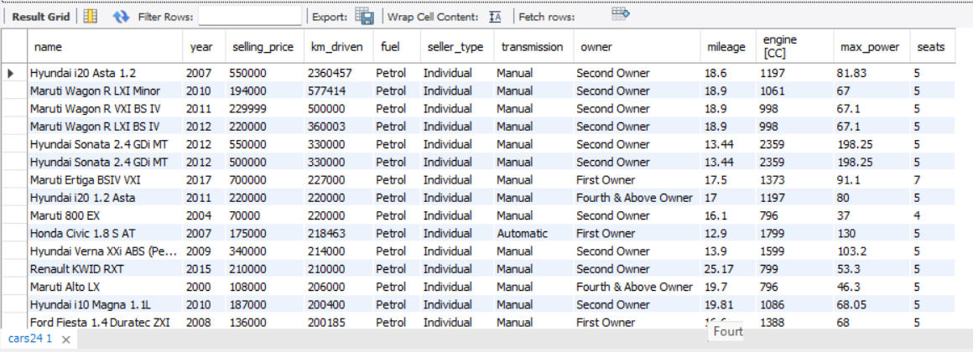
“Select” Use project; Select * from cars24;

Slide 4
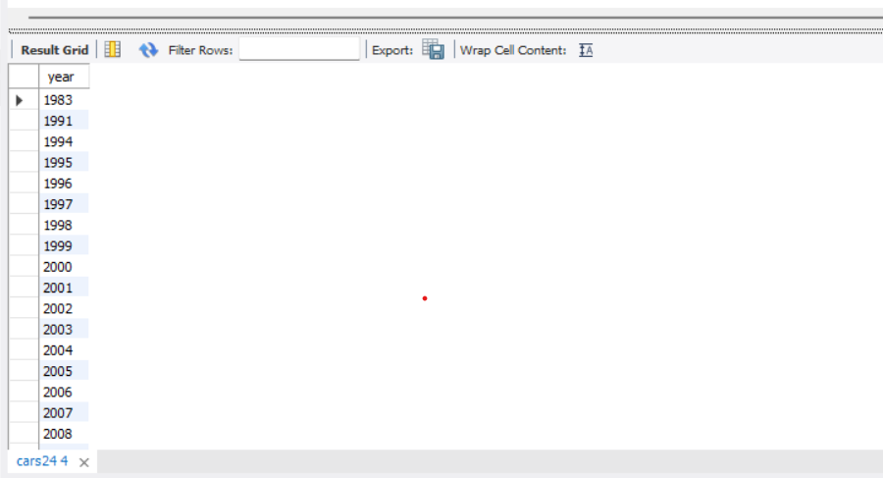
“Distinct” select Distinct year from cars24 order by year;

Slide 5
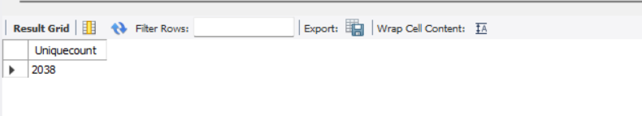
“Count” Select count(distinct name) As Unique_count from cars24

Slide 6
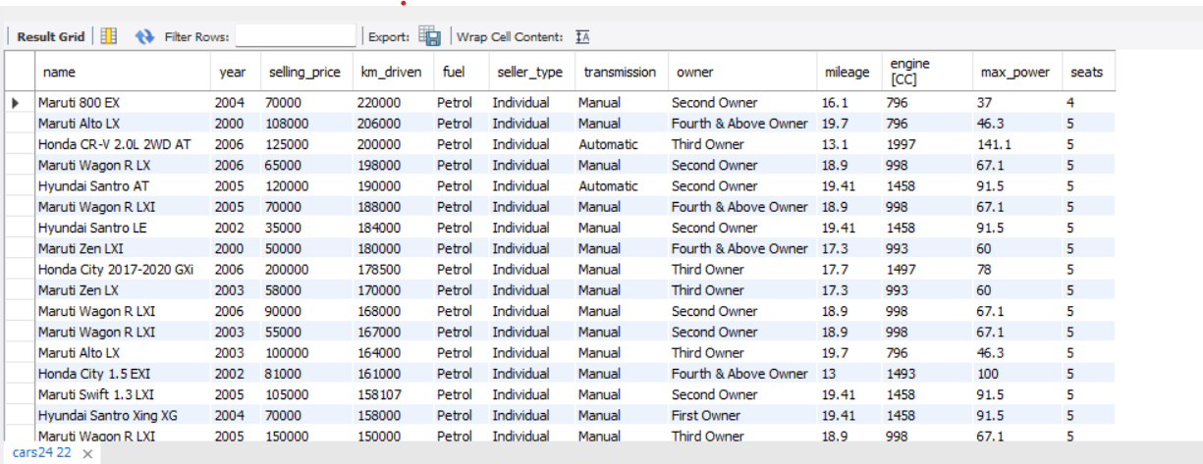
WHERE & LOGICAL OPERATORS “AND” Select * from cars24 where year < 2007 and selling_price < 220000;

Slide 7
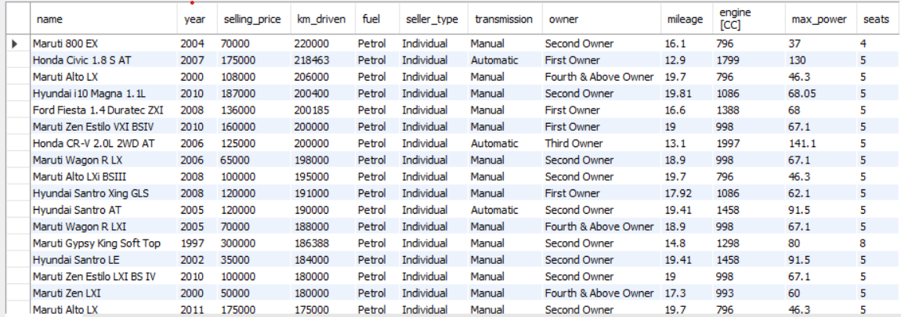
”OR” Select * from cars24 where year < 2004 or selling_price < 188000;

Slide 8
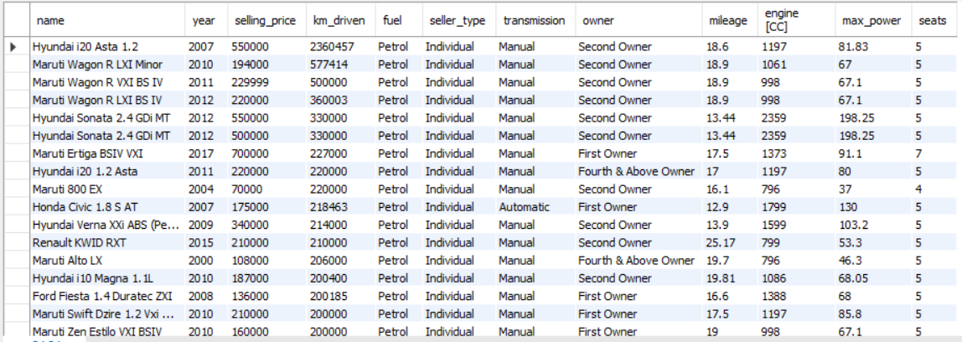
”NOT” Select * from cars24 where not year < 2004 or selling_price < 188000;

Slide 9
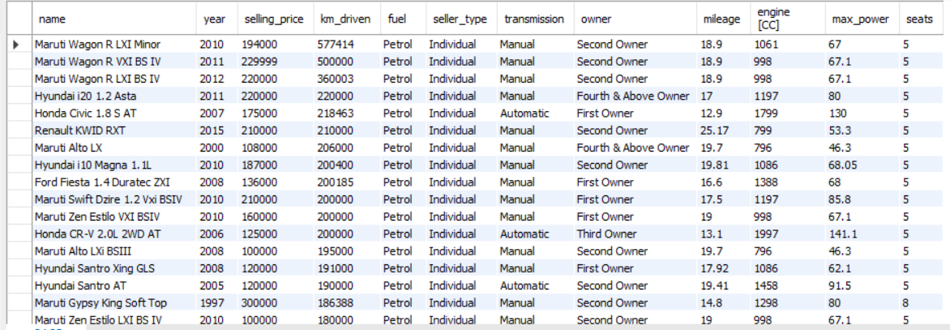
“BETWEEN” Select * from cars24 where selling_price between 100000 and 300000;

Slide 10
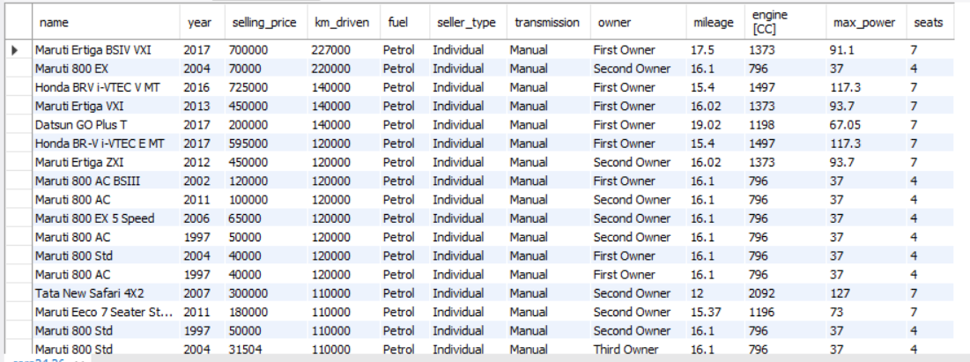
“IN” & “NOT IN” Select * from cars24 where seats in ('4','7’);

Slide 11
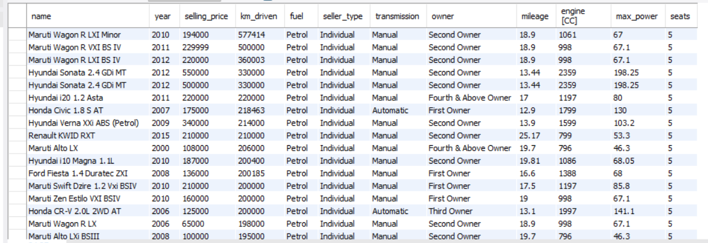
Select * from cars24 where seats not in ('4','7’);

Slide 12
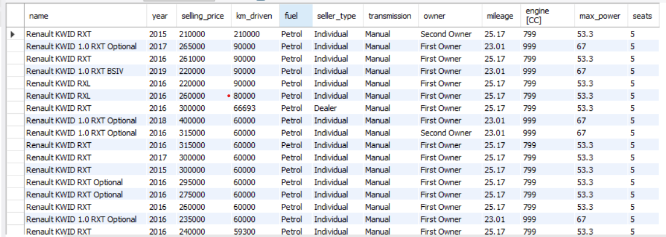
“LIKE” and “%” Select * from cars24 where name LIKE 'R%’;

Slide 13
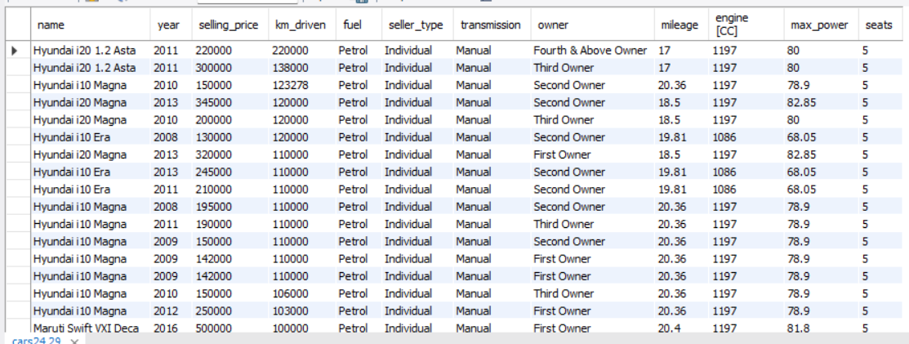
Select * from cars24 where name LIKE '%a’;

Slide 14
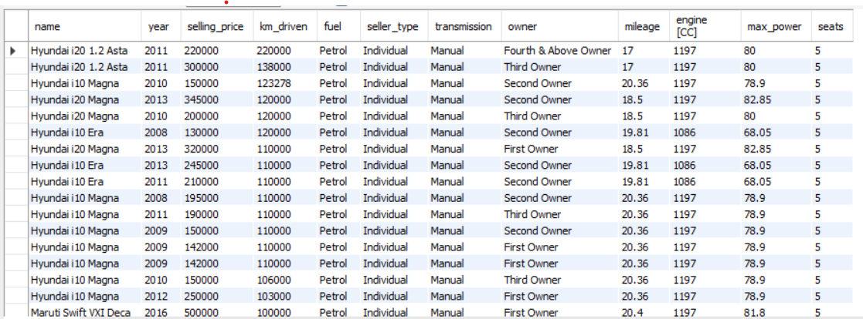
“LIKE” and “_” Select * from cars24 where name LIKE '%_a’;

Slide 15
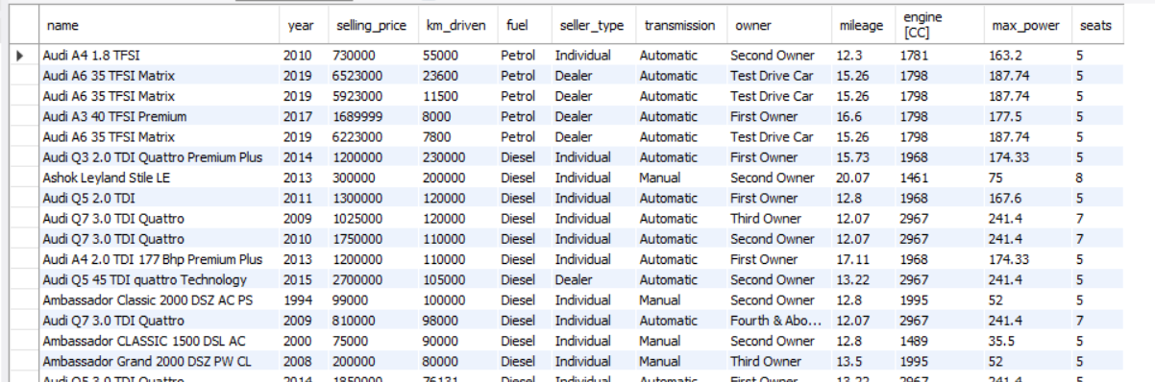
Select * from cars24 where name LIKE 'a_%’;

Slide 16
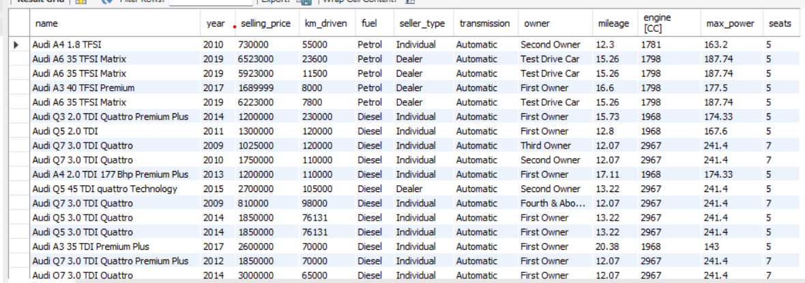
“REGEXP” Select * from cars24 where name REGEXP '^audi’;

Slide 17
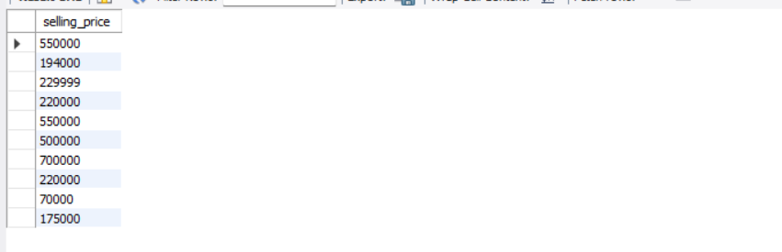
“LIMIT” Select selling_price from cars24 LIMIT 10;

Slide 18
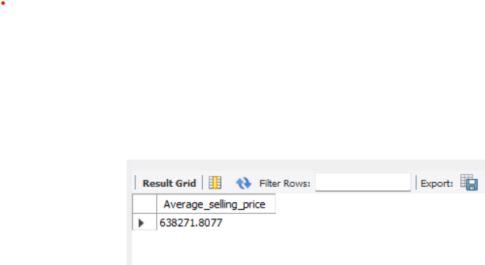
AGGREGATORS “Average” Select avg(selling_price) as Average_selling_price from cars24;

Slide 19

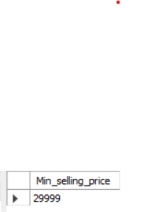
“MAX” Select max(selling_price) as Max_selling_price from cars24; “MIN” Select min(selling_price) as Min_selling_price from cars24;

Slide 20
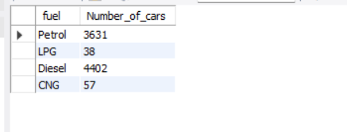
“COUNT” and “GROUPBY” and “ORDERBY” Select fuel, Count(*) AS Number_of_cars from cars24 Group by fuel;

Slide 21
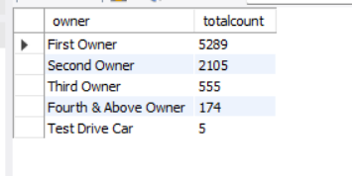
Select owner, Count(*) as totalcount from cars24 Group by owner Order by 2 desc;

Slide 22
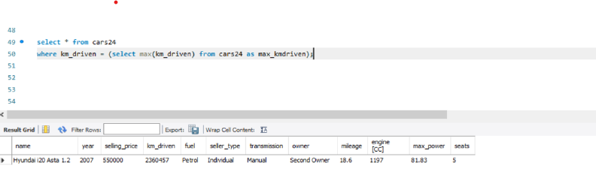
“SUB QUERIES” select max(km_driven) from cars24 as max_kmdriven; select * from cars24 where km_driven = (select max(km_driven) from cars24 as max_kmdriven);

Slide 23
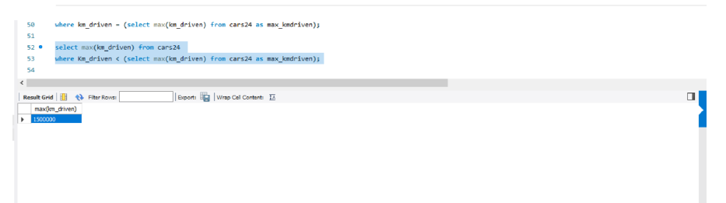

Slide 24
Conclusion/Findings
We have found useful insights using SQL Queries that will help to grow the business
We used logical operators like AND,OR,BETWEEN,IN to find insights
We used REGEXP and LIKE to find specific strings in the dataset
We used aggregators like AVERAGE,MAX,MIN to find the average, max, min selling price over the years
We used GROUPBY to group records with shared values and ORDERBY to sort results in ascending or descending order based on the column
We used SUBQUERIES to divide the complex query into isolated queries

Slide 25
THANK YOU

